Slide 1
Systematic case presentation
Company E

Slide 2
Work process
Stakeholde requirements definition process
Requirement analysis process
→ Case specific SRS (as main-contractor)
→ Case specific SRS (to sub-contractor)
Architectural design process + Systematic template
→ Case specific DDD (as main-contractor)
→ Case specific DDD (as sub-contractor)
→ Case specific ICD
Contact to our sub-contractor
→ Analysis → Requirements → Initial contact → Clearification of requirements → Answer → Final meeting

Slide 3
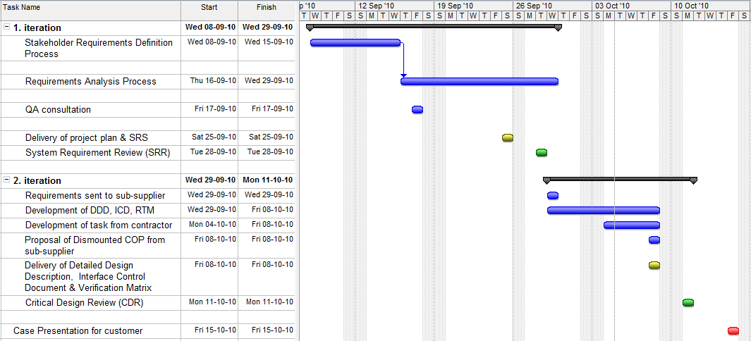
Scheduling

Slide 4
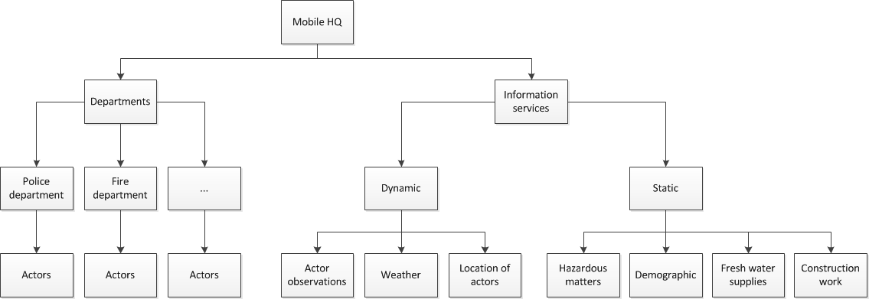
Case focus

Slide 5
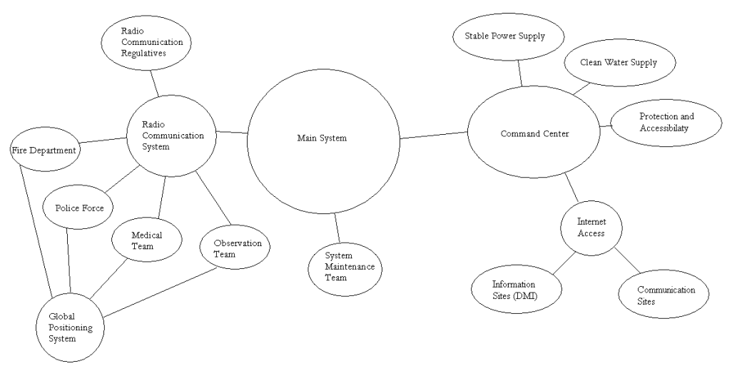
Requirements Elicitation

Slide 6
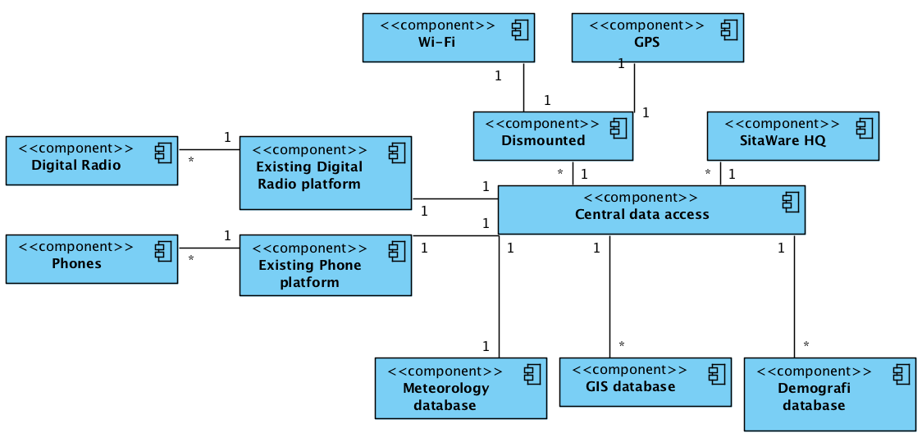
Design Elements

Slide 7
Dismounted COP

Slide 8
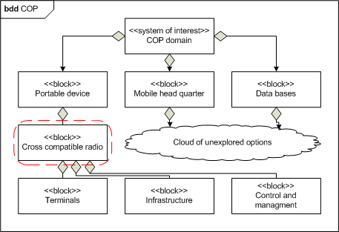
Interface Elements

Slide 9
What to do next?
Domain knowledge
Role of involved actors
Hardware
Adjustment of SitaWare platform e.g. new radio unit
Software
User interface / user experience
Communication interface structure

